Slide 1

Swarm Behavior Classification
Student: 曾德懿
Student ID: 2019051712
Supervisor: 朱小红

Slide 2
1. Introduction

Slide 3

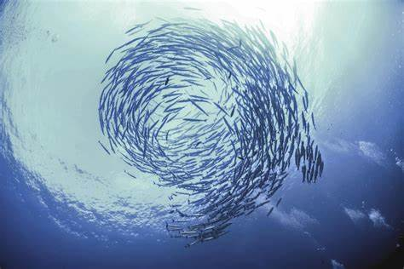
Swarm Behaviors In Nature
Flocking birds
Schooling fish

Slide 4
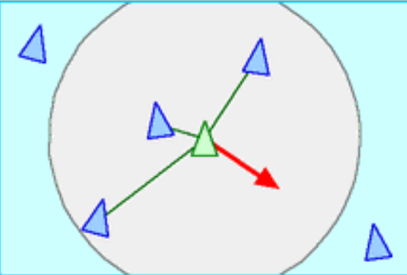
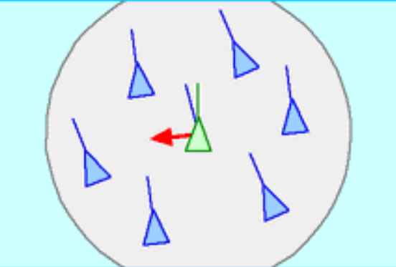
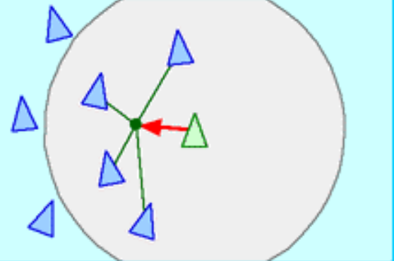
Interactive Forces
Separation Force
Alignment Force
Alignment Force

Slide 5
2. Dataset and Problems

Slide 6
Q: Why did we choose this for classification?
A: The biologists said that, when publishing this task and dataset, although it is easy for human-beings to recognize the behaviors of a swarm, it is hard for computers to do that.
Study the interaction between boids in the swarm
Inspire the advancement of computing science
3. Enlighten the management of sophisticated systems
Q: Where did this dataset come from?
A: This dataset comes from a computational simulation of swarm behaviors, conducted by biologists and computing scientists from the University of New South Wales.

Slide 7
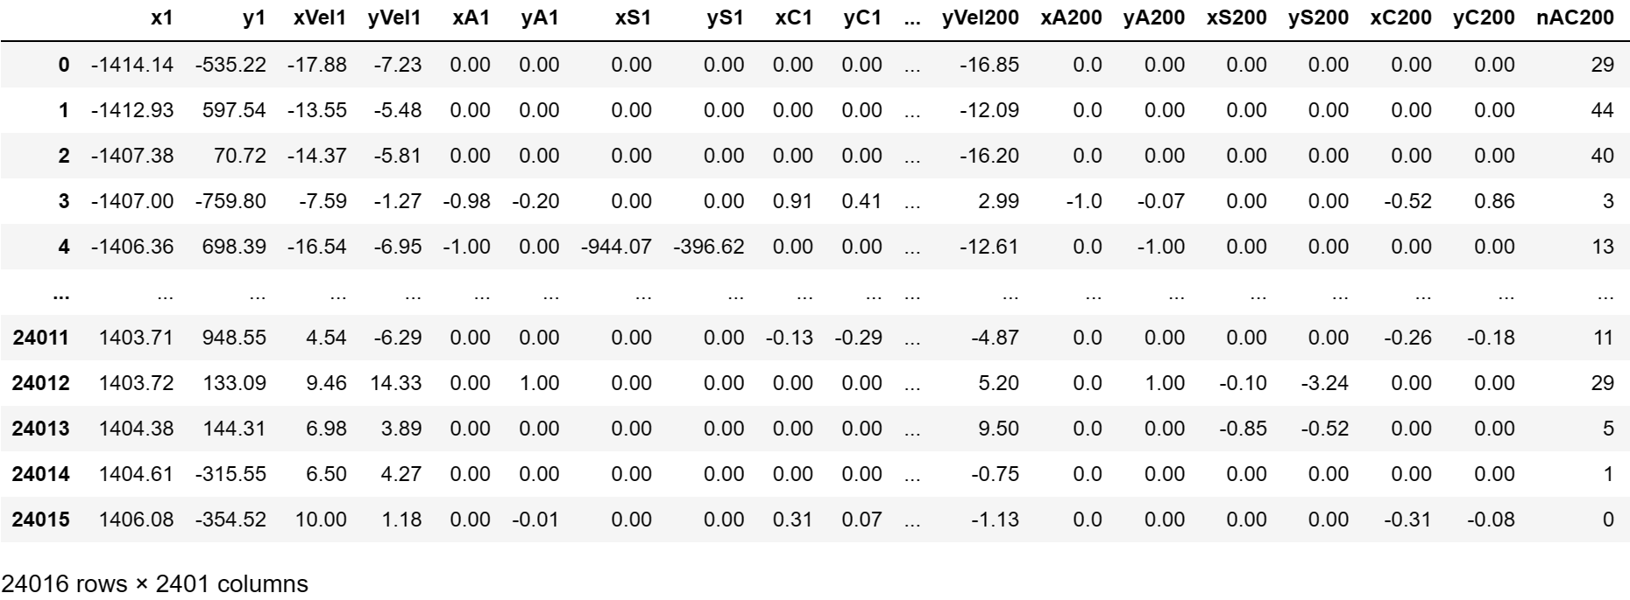
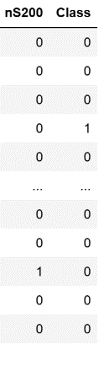
Dataset

Slide 8
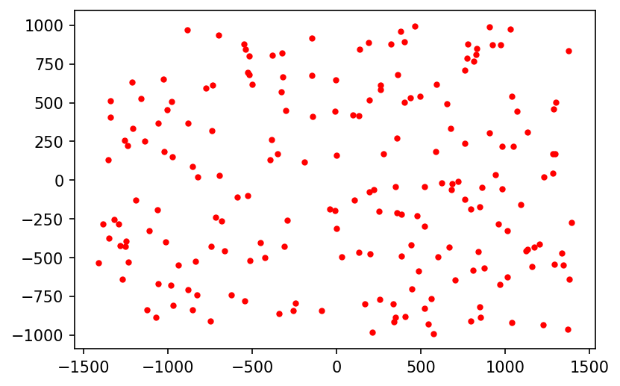
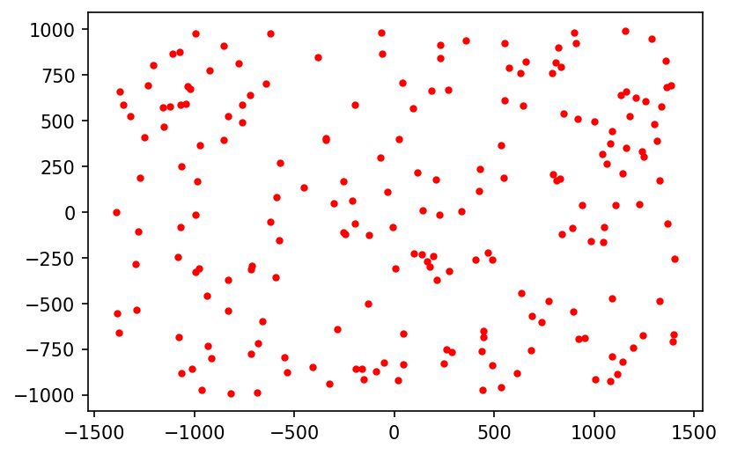
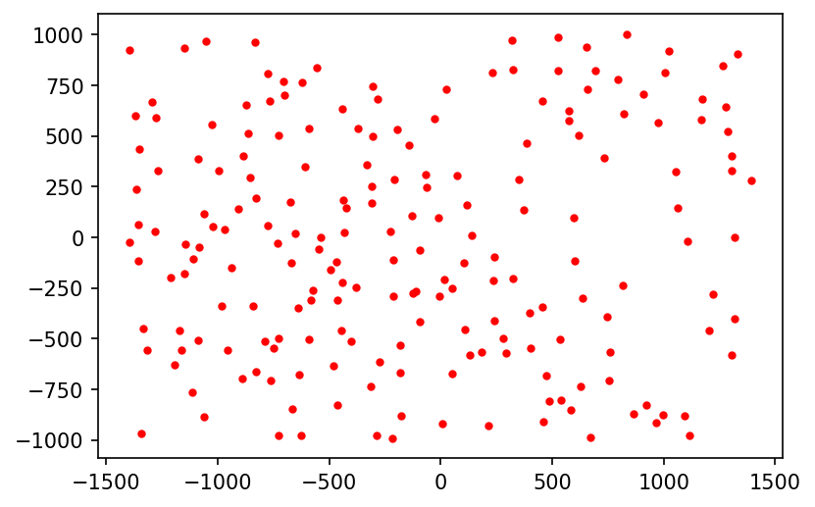
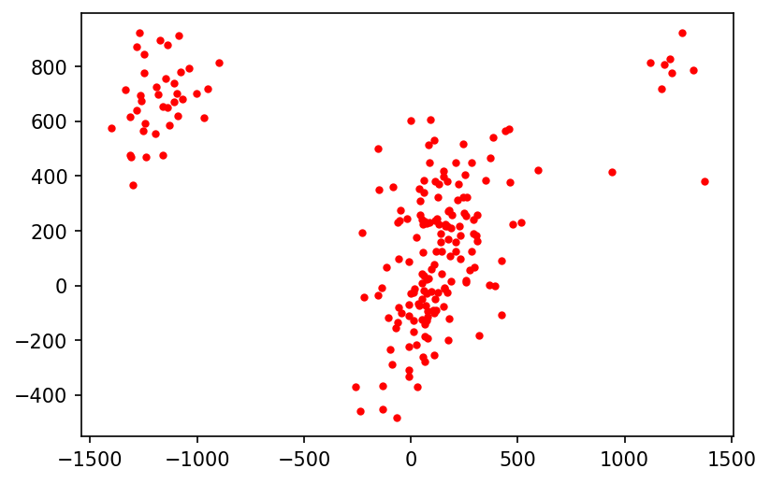
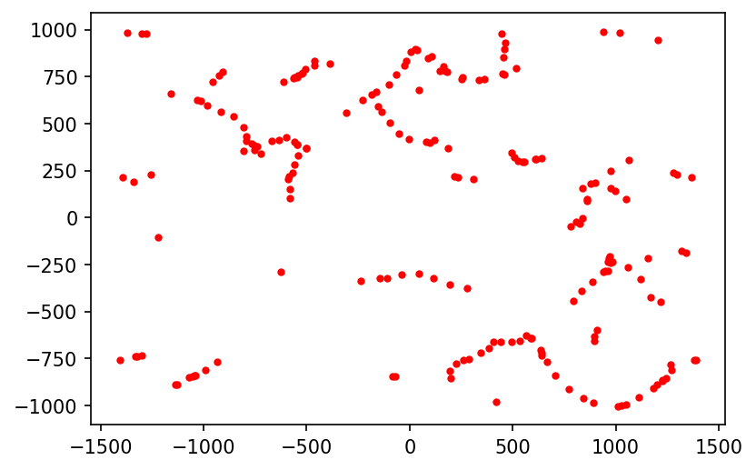
Swarms Behavior in Dataset
No Swarm Behavior
flocking, non-grouping, non-aligning
flocking, non-grouping, aligning
flocking, grouping, non-aligning
flocking, grouping, aligning

Slide 9
Two binary classification tasks
Classification based on coordinate and velocity of 200 boids in swarms and analyze the importance of features
Classification based on three forces of 200 boids in swarms and analyze the importance of features

Slide 10
3. Procedures

Slide 11
Binary Classification of Swarm Behavior Based on Coordinate and Velocity
No Processing
Centroid Method
2D Mapping Method
K-nearest Neighbor
Random Forest
Logistic Regression
Multilayer Perceptron
Convolutional Neural Network
Permutation Importance
Feature Processing Method
Classification Method
Analysis of Features Importance
There are 3 sub-tasks:
1. Binary Classification of flocking behavior based on coordinate and velocity
2. Binary Classification of grouping behavior based on coordinate and velocity
3. Binary Classification of aligning behavior based on coordinate and velocity

Slide 12
Binary Classification of Swarm Behavior Based on Three Forces
No Processing
Centroid Method
2D Mapping Method
K-nearest Neighbor
Random Forest
Logistic Regression
Multilayer Perceptron
Convolutional Neural Network
Gini Importance
Feature Processing Method
Classification Method
Analysis of Features Importance
There are 3 sub-tasks:
1. Binary Classification of flocking behavior based on three forces
2. Binary Classification of grouping behavior based on three forces
3. Binary Classification of aligning behavior based on three forces

Slide 13
4. Feature Processing

Slide 14
(1) No Processing
$$x_{1},y_{1},{xVel}_{1},{yVel}_{1},……,x_{200},y_{200},{xVel}_{200},{yVel}_{200}$$
KNN
Random Forest
Logistic Regression
Multilayer Perceptron
$${xA}_{1},{yA}_{1},{xS}_{1},{yS}_{1},{xC}_{1},{yC}_{1},{nAC}_{1},{nS}_{1},……,$$
$${xA}_{200},{yA}_{200},{xS}_{200},{yS}_{200},{xC}_{200},{yC}_{200},{nAC}_{200},{nS}_{200}$$

Slide 15
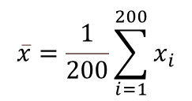
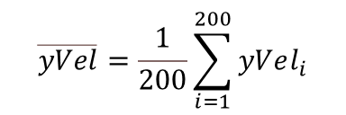
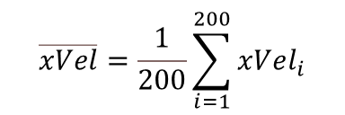
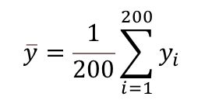
(2) Centroid Method
$$x_{1},y_{1},{xVel}_{1},{yVel}_{1},……,x_{200},y_{200},{xVel}_{200},{yVel}_{200}$$
$$\overline{x}=\frac{1}{200}\sum_{i=1}^{200}{x_{i}}$$
$$\overline{y}=\frac{1}{200}\sum_{i=1}^{200}{y_{i}}$$
$$\overline{xVel}=\frac{1}{200}\sum_{i=1}^{200}{xVel_{i}}$$
$$\overline{yVel}=\frac{1}{200}\sum_{i=1}^{200}{yVel_{i}}$$
$$\overline{x},\overline{y},\overline{xVel},\overline{yVel}$$
KNN
Random Forest
Logistic Regression
Multilayer Perceptron

Slide 16
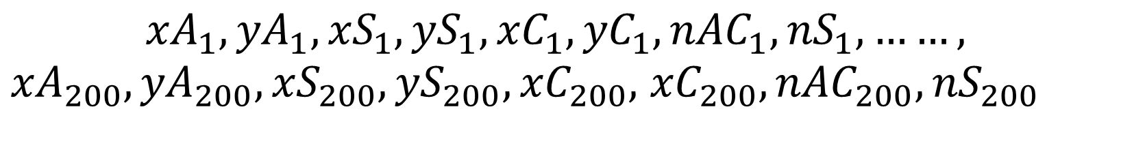
(2) Centroid Method
$${xA}_{1},{yA}_{1},{xS}_{1},{yS}_{1},{xC}_{1},{yC}_{1},{nAC}_{1},{nS}_{1},……,$$
${xA}_{200},{yA}_{200},{xS}_{200},{yS}_{200},{xC}_{200},$ ${xC}_{200},{nAC}_{200},{nS}_{200}$
$\overline{xA},\overline{yA},\overline{xS},\overline{yS},$ $\overline{xC},\overline{yC},$ $\overline{nAC},\overline{nS}$
KNN
Random Forest
Logistic Regression
Multilayer Perceptron

Slide 17
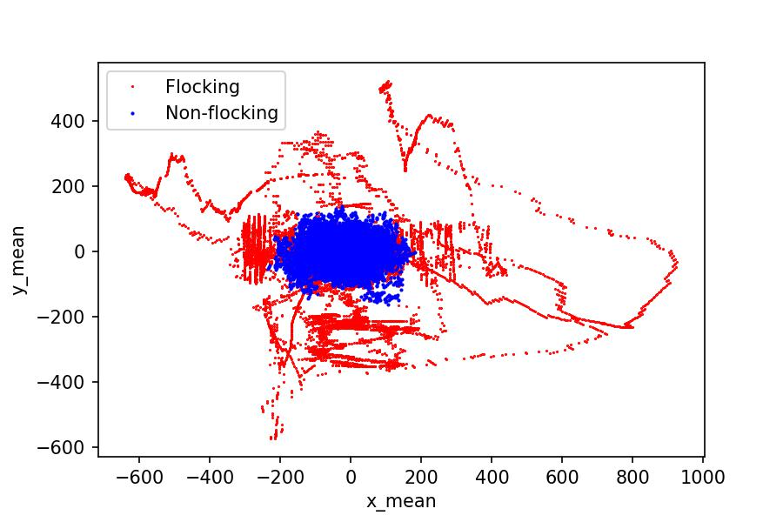
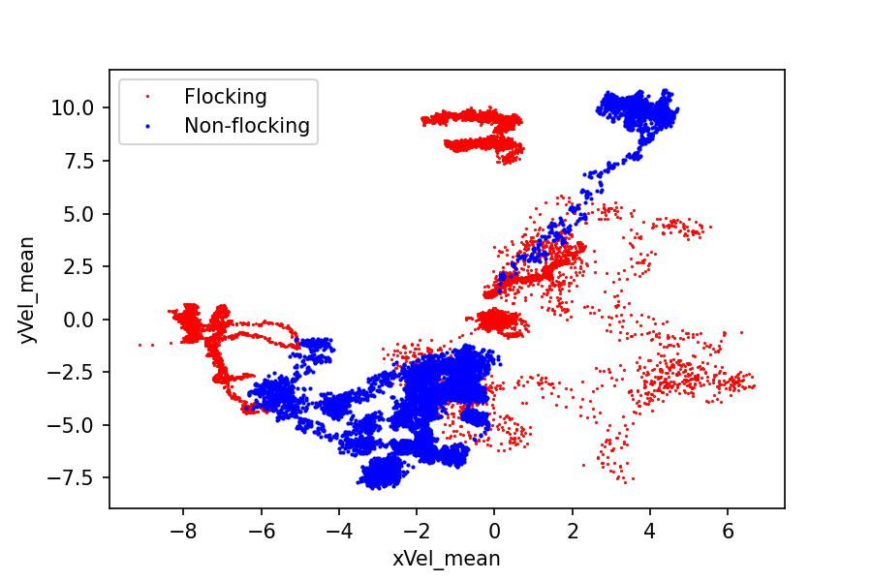
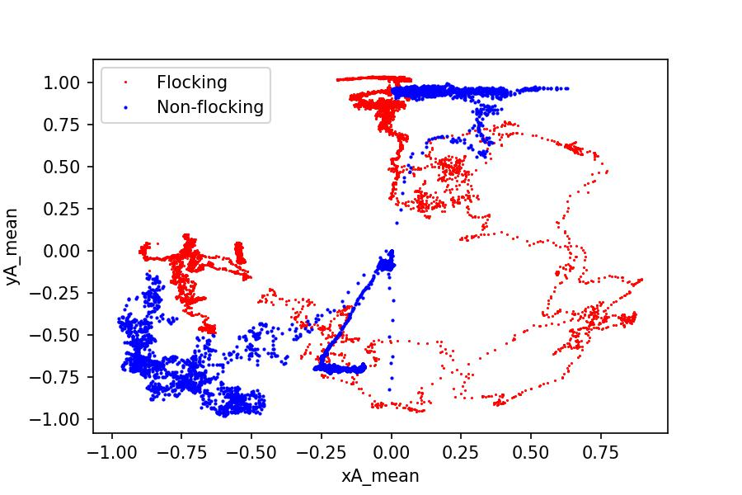
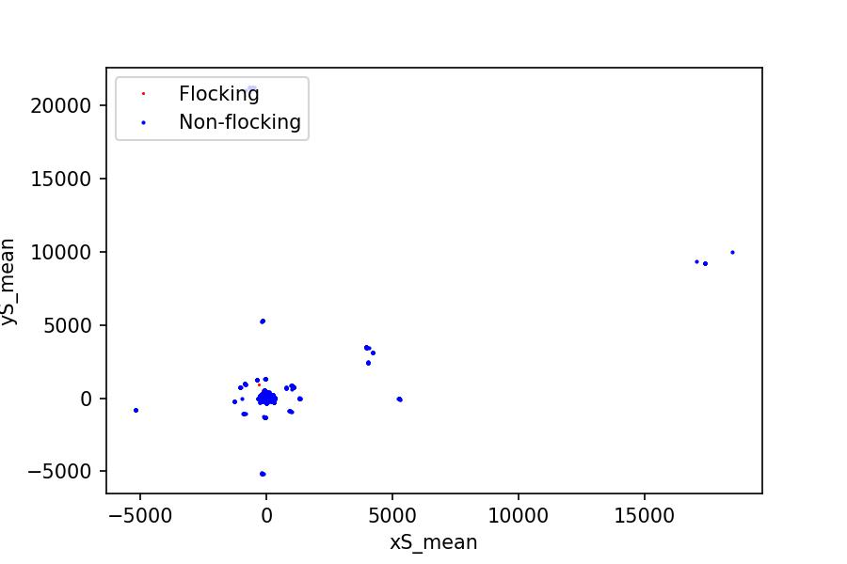
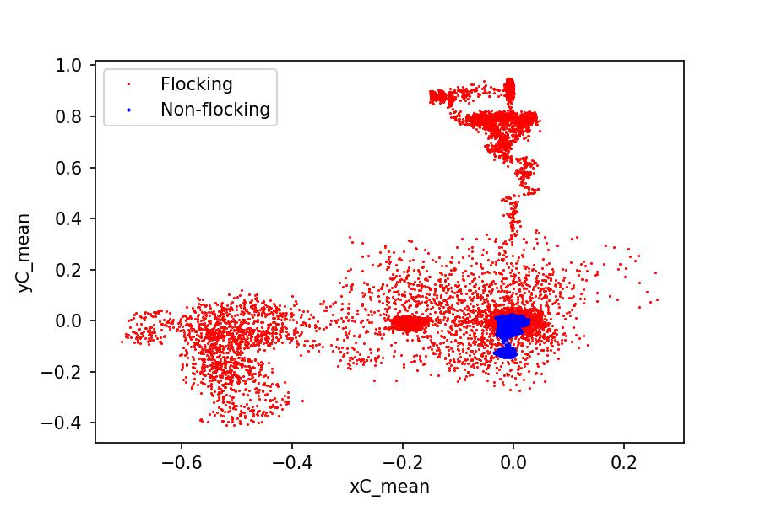
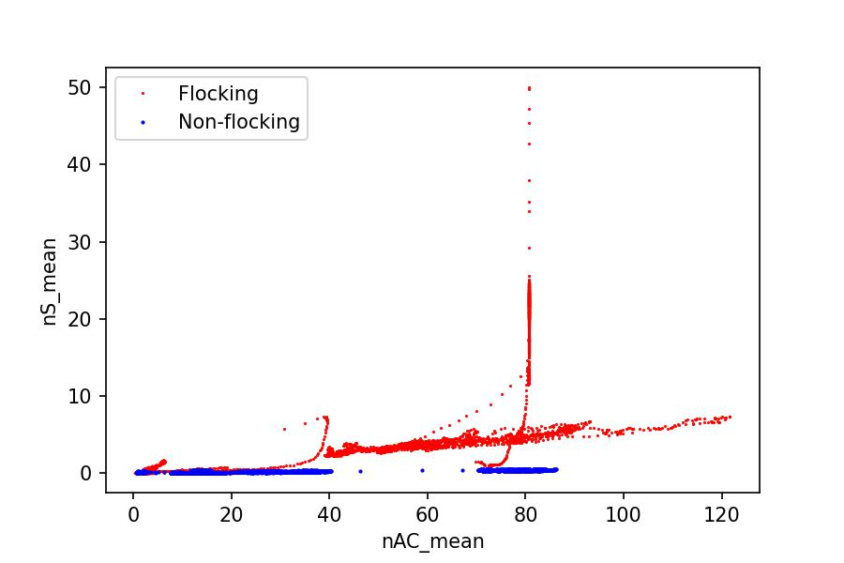
(b) Velocity of Centroids
(c) Alignment Force of Centroids
(a) Positional Coordiante of Centroids
(d) Separation Force of Centroids
(f) Number of Boids in Radius of Centroids
(e) Cohesion Force of Centroids

Slide 18
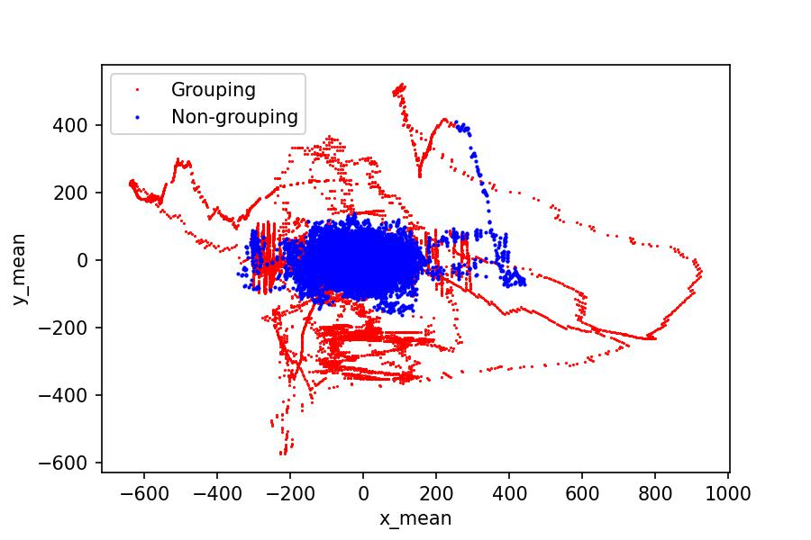
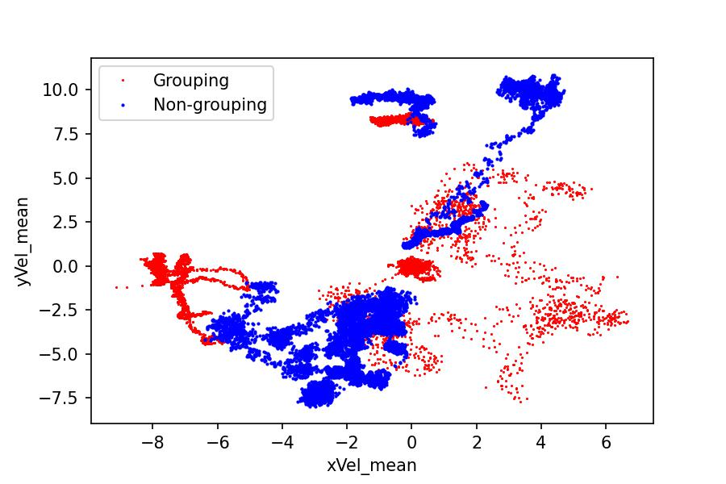
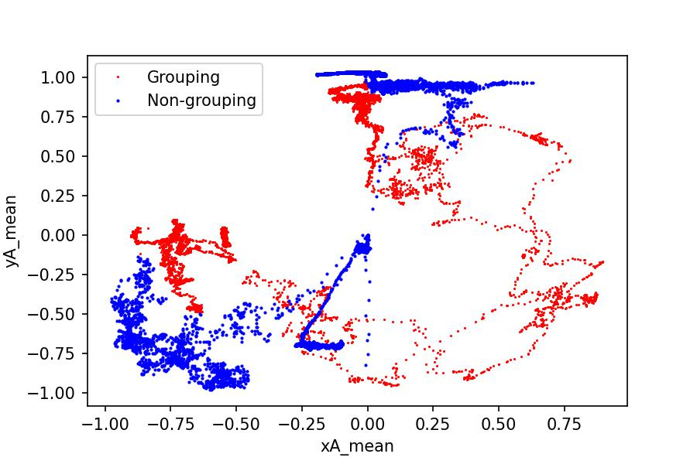
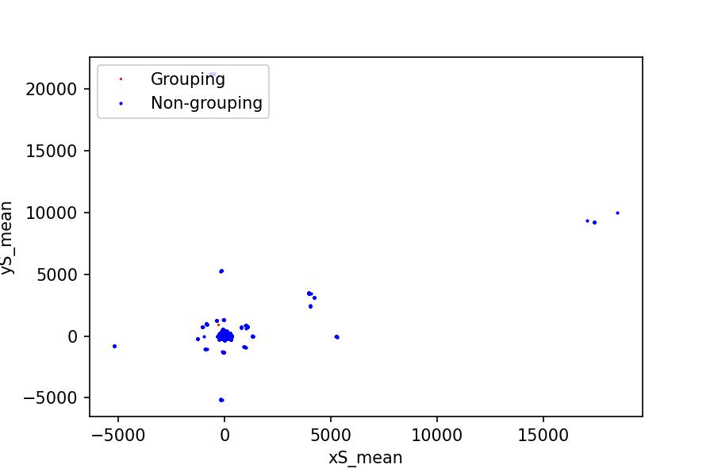


(b) Velocity of Centroids
(c) Alignment Force of Centroids
(a) Positional Coordiante of Centroids
(d) Separation Force of Centroids
(f) Number of Boids in Radius of Centroids
(e) Cohesion Force of Centroids

Slide 19
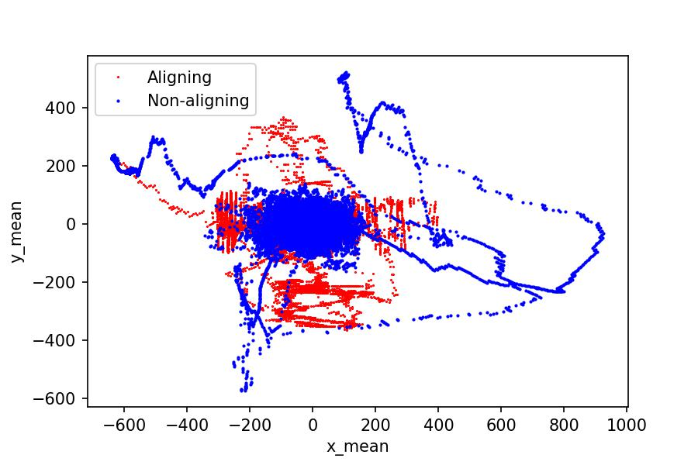
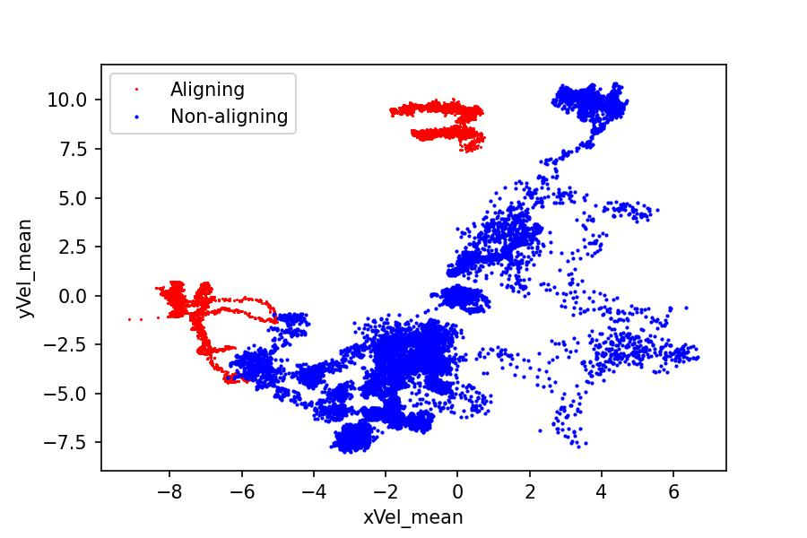
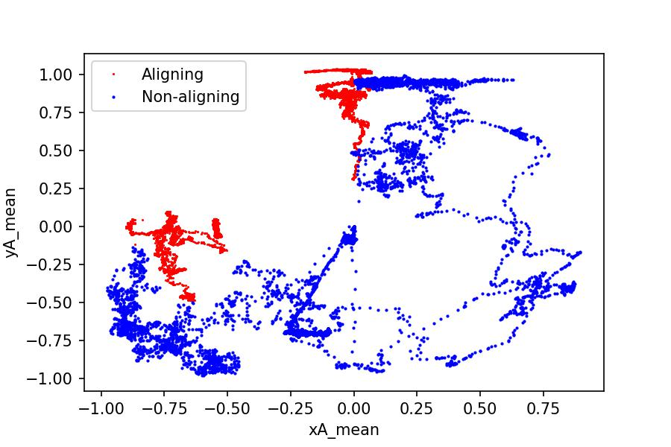
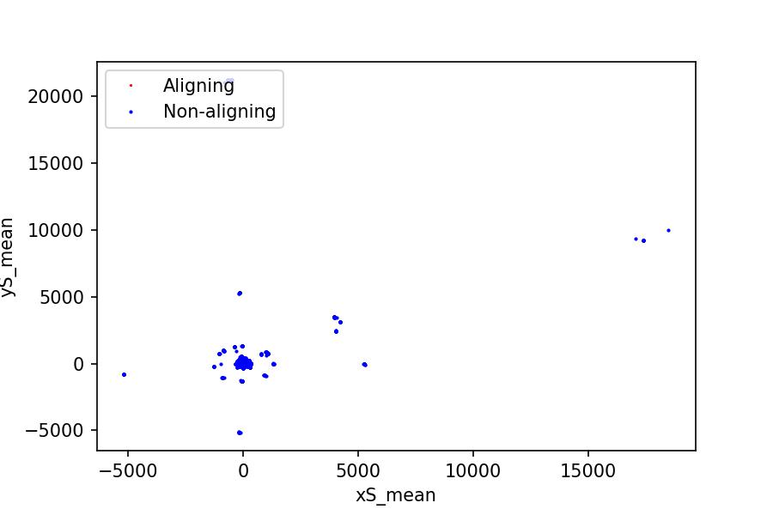
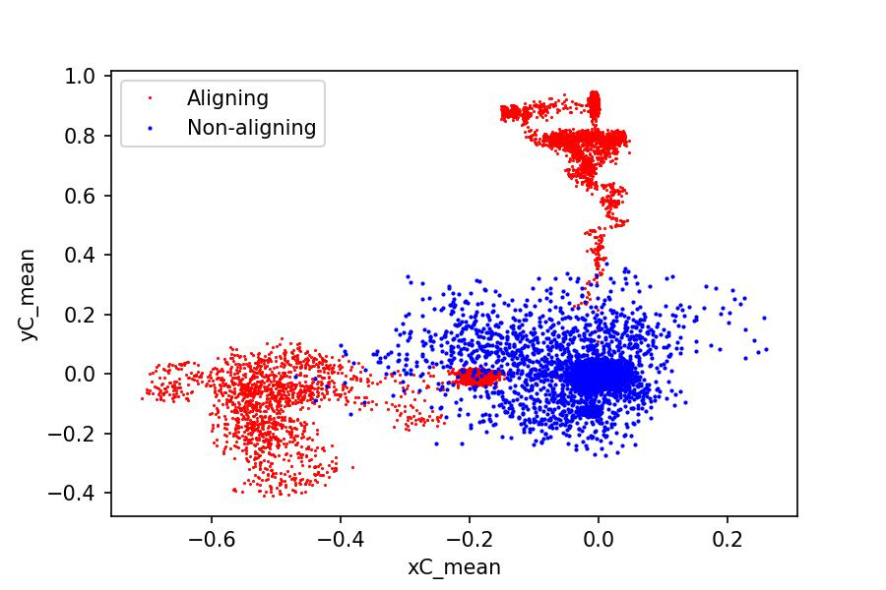
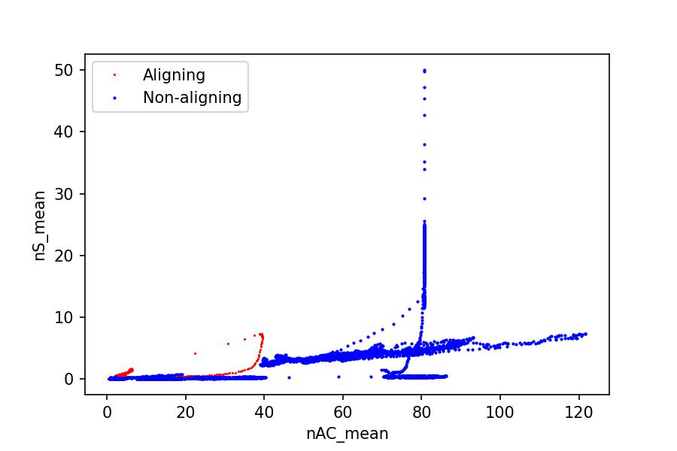
(b) Velocity of Centroids
(c) Alignment Force of Centroids
(a) Positional Coordiante of Centroids
(d) Separation Force of Centroids
(f) Number of Boids in Radius of Centroids
(e) Cohesion Force of Centroids

Slide 20
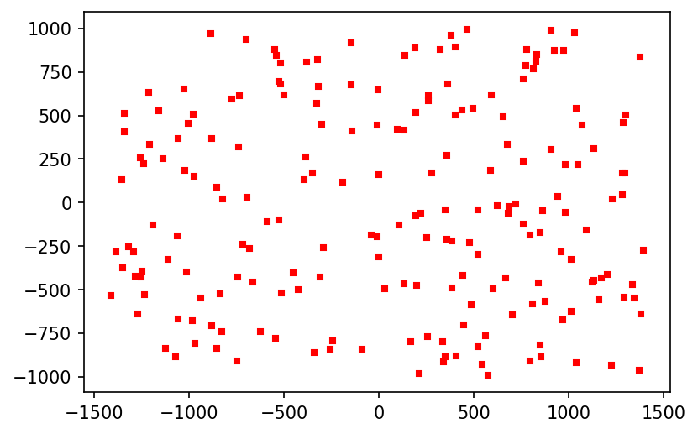
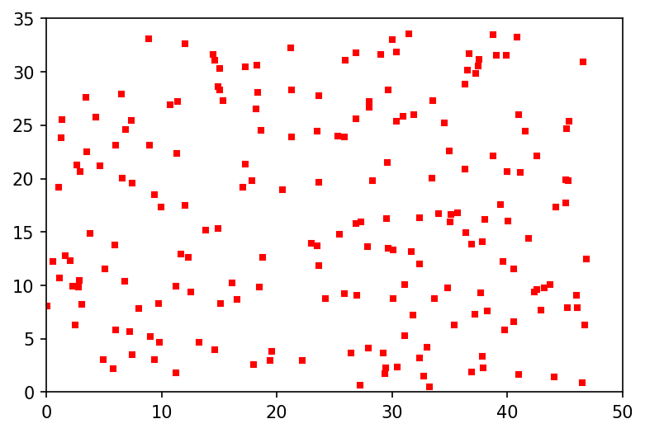
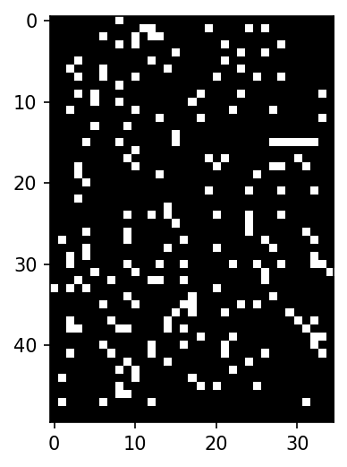
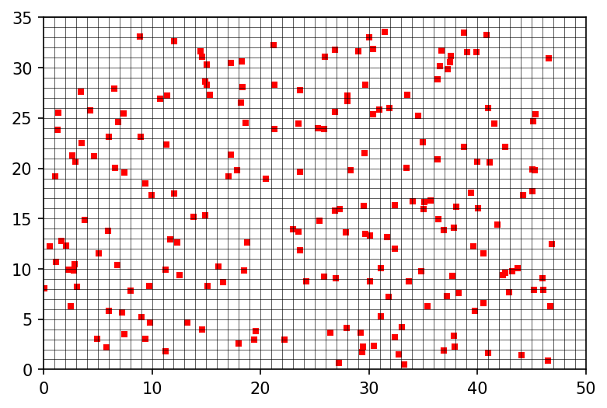


(3) 2D Mapping Method: Step 1
$$x_{1},y_{1},……,$$
$$x_{200},y_{200}$$
Map the coordinate onto the 2D plane
Rescale the plane
Mesh the plane
$$Indicator$$
Detect the existence of boids on each pixel
This image is an indicator

Slide 21
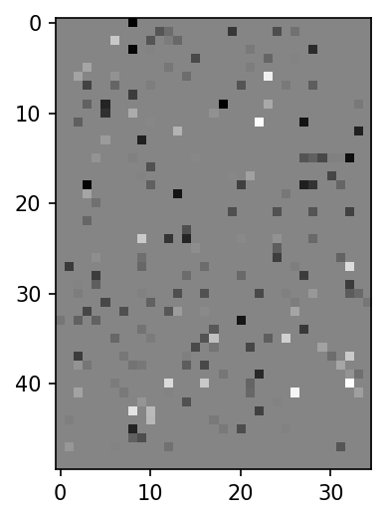
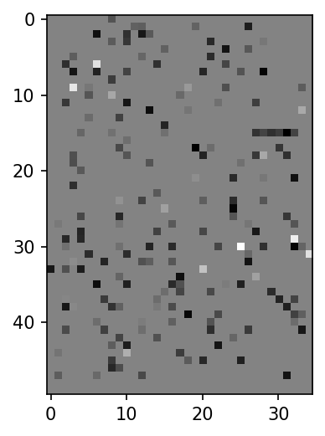




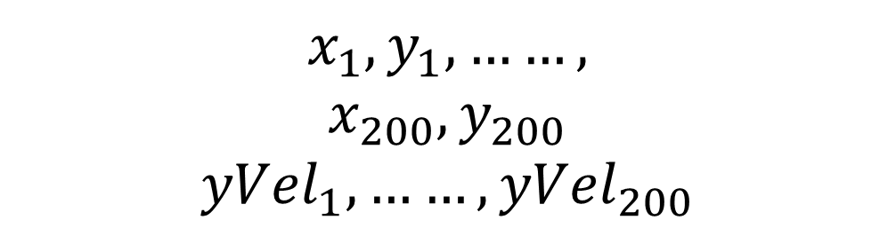
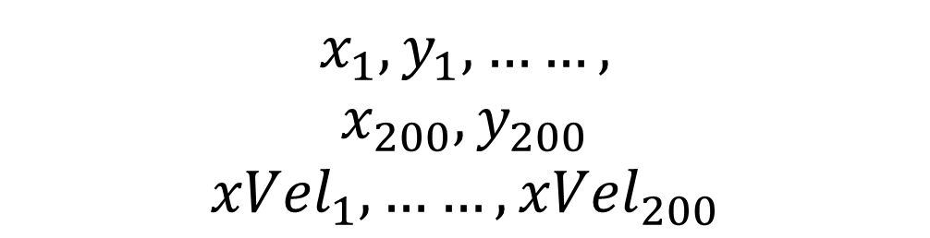
(3) 2D Mapping Method: Step 2
$$x_{1},y_{1},……,$$
$$x_{200},y_{200}$$
Map other features on the plane, based on the coordinate
$$Indicator$$
$$x_{1},y_{1},……,$$
$$x_{200},y_{200}$$
$${xVel}_{1},……,{xVel}_{200}$$
$$2D xVel$$
$$x_{1},y_{1},……,$$
$$x_{200},y_{200}$$
$${yVel}_{1},……,{yVel}_{200}$$
$$2D yVel$$

Slide 22
(3) 2D Mapping Method: Step 3
$$Indicator,2D xVel, 2D yVel$$
KNN
Random Forest
Logistic Regression
Multilayer Perceptron
$$2D xA, 2D yA, 2D xS, 2D yS, 2D xC, 2D yC, 2D nAC, 2D nS$$

Slide 23
5. Classifiers

Slide 24
(1) KNN (K = {1,2,……,8}) (2) Random Forst (CART Decision Tree used, Number of Decision Trees = {20,40,60,……,200}) (3) Regularized Logistic Regression

Slide 25
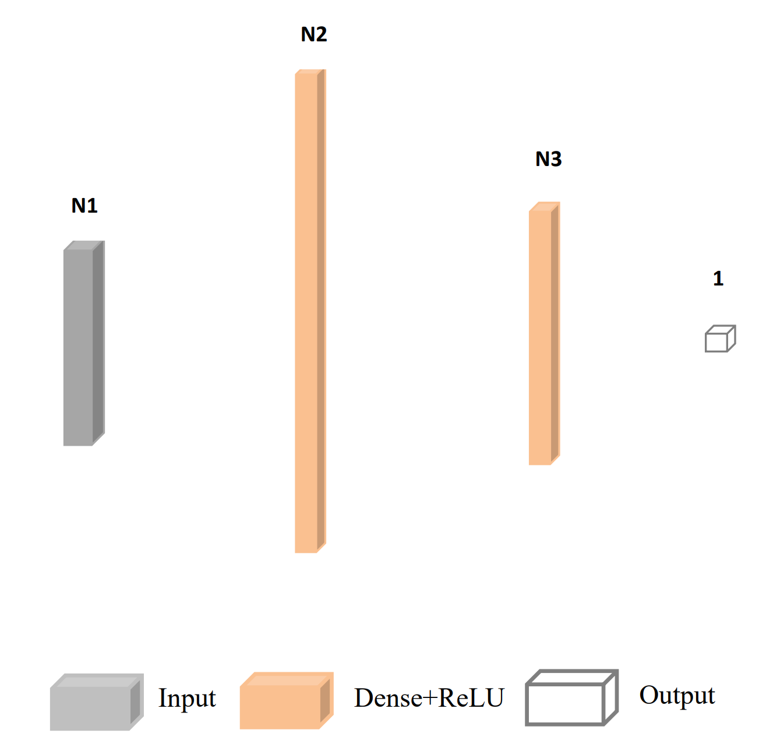
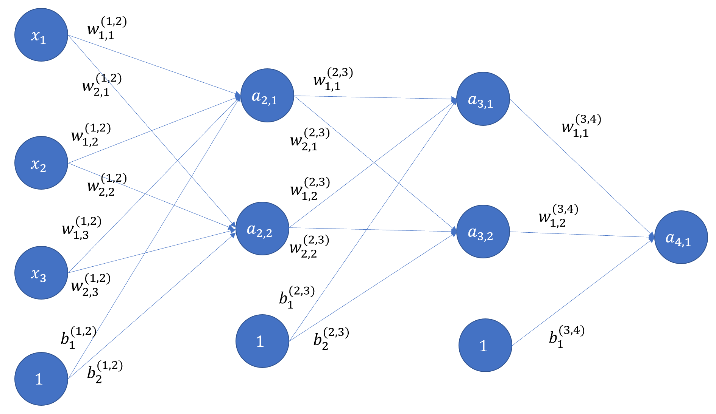
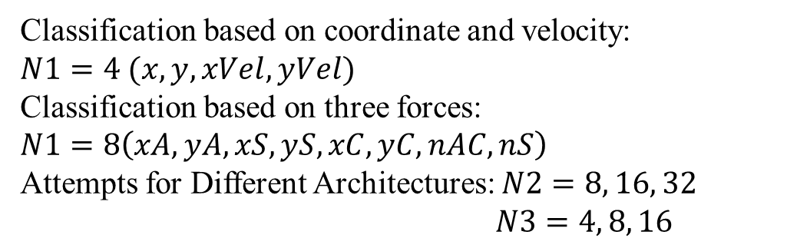
(4) Muti-layer Perceptron (Artificial Neural Network)
Classification based on coordinate and velocity:
$N1=4 (x,y,xVel,yVel)$
Classification based on three forces:
$N1=8\left(xA,yA,xS,yS,xC,yC,nAC,nS\right)$
Attempts for Different Architectures: $N2=8, 16, 32$
$N3=4, 8, 16$

Slide 26
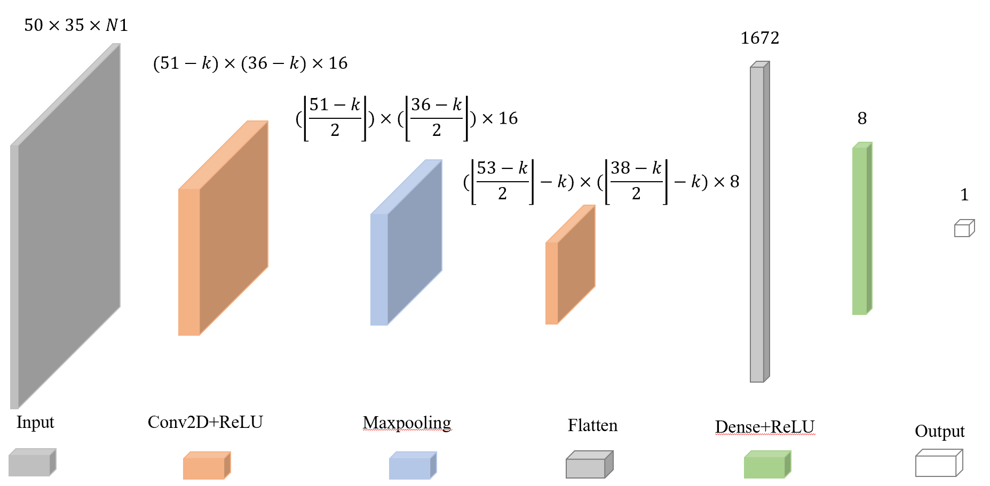
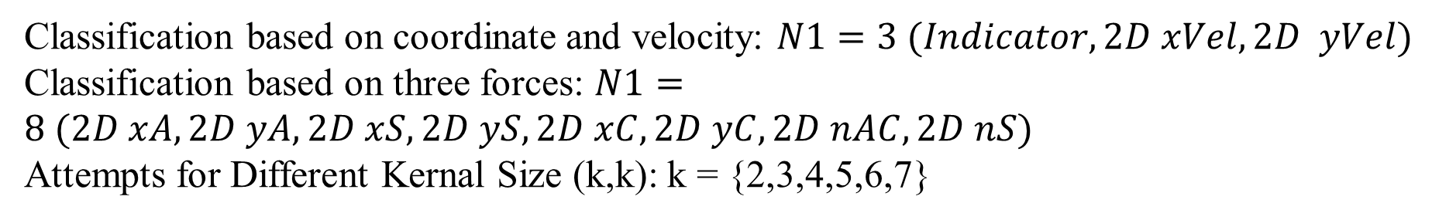
(5) Convolutional Neural Network
Classification based on coordinate and velocity: $N1=3 (Indicator, 2D xVel,2D yVel)$
Classification based on three forces: $N1=8 (2D xA,2D yA,2D xS,2D yS,2D xC,2D yC,2D nAC,2D nS)$
Attempts for Different Kernal Size (k,k): k = {2,3,4,5,6,7}

Slide 27
6. Classification Results

Slide 28
(1) Classification Based on Coordinate and Velocity
Behaviors | Feature Processing Method | Optimal Classifiers | Precision | Recall | F1-score | Accuracy
Flocking | No Processing | MLP | 0.7535 | 0.8857 | 0.8143 | 0.8231
 | Centroid Method | KNN | 0.9733 | 0.999 | 0.9860 | 0.9858
 | 2D Mapping Method | CNN | 0.9968 | 1.0000 | 0.9984 | 0.9984
Grouping | No Processing | MLP | 0.3940 | 0.5939 | 0.4737 | 0.5983
 | Centroid Method | Random Forest | 0.8896 | 0.9897 | 0.9370 | 0.9451
 | 2D Mapping Method | CNN | 0.9296 | 0.9879 | 0.9578 | 0.9624
Aligning | No Processing | Random Forest | 0.9797 | 1.0000 | 0.9897 | 0.9925
 | Centroid Method | KNN | 1.0000 | 1.0000 | 1.0000 | 1.0000
 | 2D Mapping Method | CNN | 1.0000 | 1.0000 | 1.0000 | 1.0000

Slide 29
(2) Classification Based on Three Forces
Behaviors | Feature Processing Method | Optimal Classifiers | Precision | Recall | F1-score | Accuracy
Flocking | No Processing | Random Forest | 0.8832 | 0.9819 | 0.9299 | 0.9315
 | Centroid Method | Random Forest | 1.0000 | 0.9993 | 0.9996 | 0.9996
 | 2D Mapping Method | CNN | 0.9995 | 1.0000 | 0.9998 | 0.9998
Grouping | No Processing | Random Forest | 0.9810 | 0.9232 | 0.9512 | 0.9538
 | Centroid Method | Random Forest | 1.0000 | 0.9954 | 0.9977 | 0.9979
 | 2D Mapping Method | CNN | 0.9391 | 0.9988 | 0.9680 | 0.9716
Aligning | No Processing | Random Forest | 0.9522 | 0.9901 | 0.9708 | 0.9789
 | Centroid Method | Random Forest | 0.9990 | 1.0000 | 0.9995 | 0.9996
 | 2D Mapping Method | CNN | 0.9895 | 1.0000 | 0.9947 | 0.9961

Slide 30
7. Importance Analysis

Slide 31
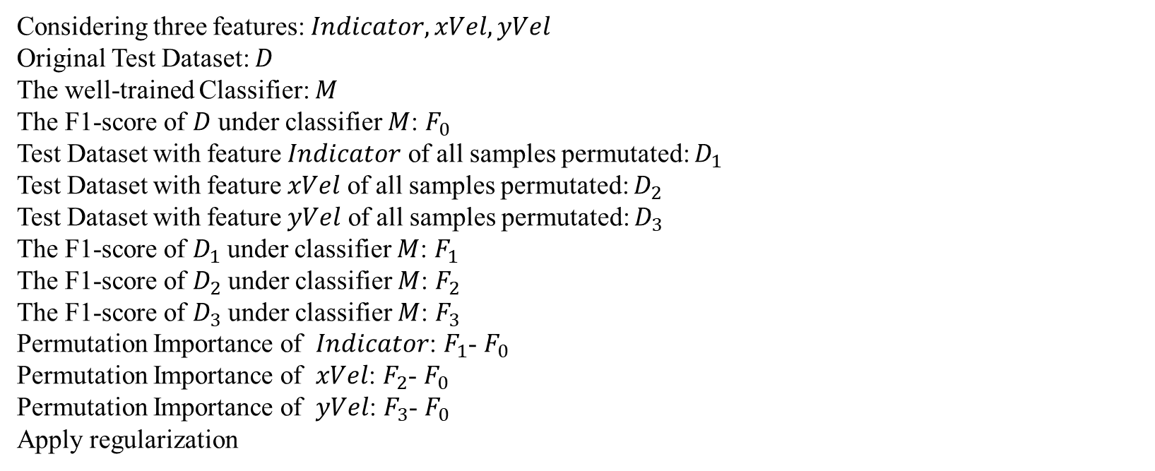
(1) Permutation Importance of Features in Classification based on Coordinate and Velocity
Considering three features: $Indicator, xVel, yVel$
Original Test Dataset: $D$
The well-trained Classifier: $M$
The F1-score of $D$ under classifier $M$: $F_{0}$
Test Dataset with feature $Indicator$ of all samples permutated: $D_{1}$
Test Dataset with feature $xVel$ of all samples permutated: $D_{2}$
Test Dataset with feature $yVel$ of all samples permutated: $D_{3}$
The F1-score of $D_{1}$ under classifier $M$: $F_{1}$
The F1-score of $D_{2}$ under classifier $M$: $F_{2}$
The F1-score of $D_{3}$ under classifier $M$: $F_{3}$
Permutation Importance of $Indicator$: $F_{1}$- $F_{0}$
Permutation Importance of $xVel$: $F_{2}$- $F_{0}$
Permutation Importance of $yVel$: $F_{3}$- $F_{0}$
Apply regularization

Slide 32
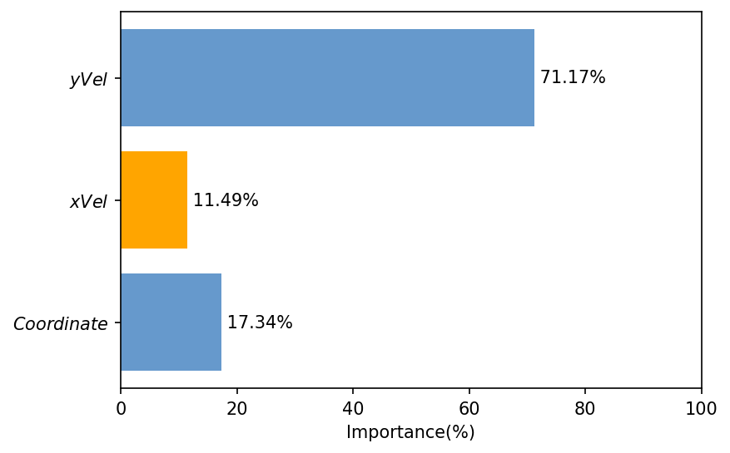
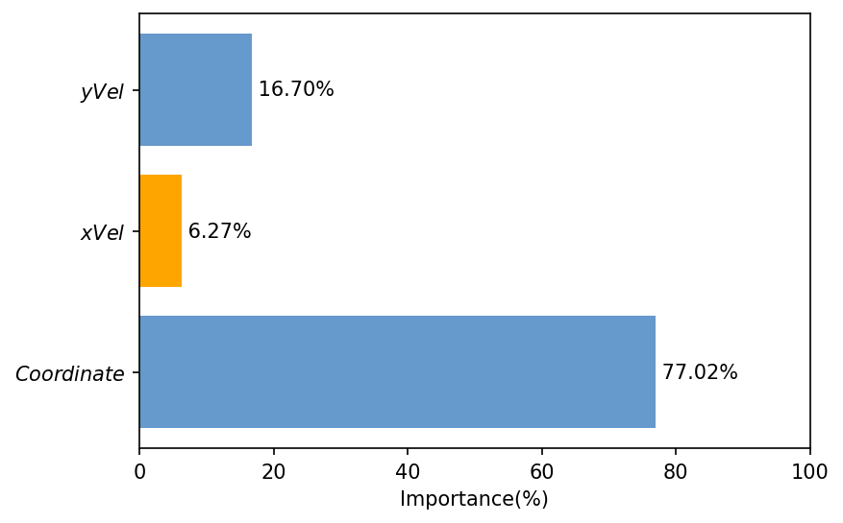
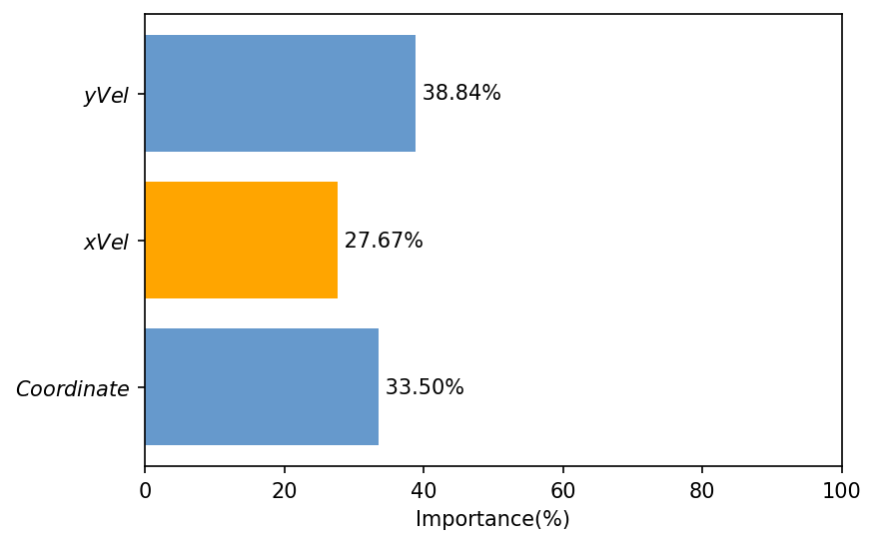
Flocking Behavior
Grouping Behavior
Aligning Behavior

Slide 33
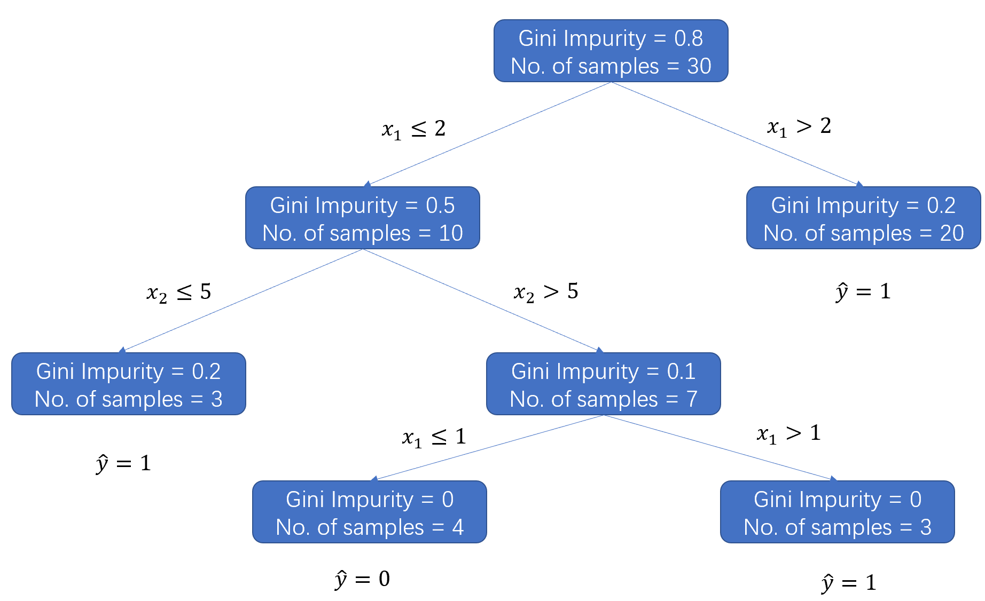
(2) Gini Importance of Features in Classification based on Three Forces
Suppose that there is a well-trained CART, the computing process of Gini importance is as follows: Traverse all splitting nodes and compute their Gini importance, then the Gini importance of a specific feature is the weighted average of splitting nodes using this feature as rule. The weight equals the sample reaches this node. The random forest consists of several CART and the Gini importance of a specific feature is the mean average of Gini importance of all CARTs that use this feature in classification.

Slide 34



Flocking Behavior
Grouping Behavior
Aligning Behavior

Slide 35
Thanks for your listening !

